Slide 1
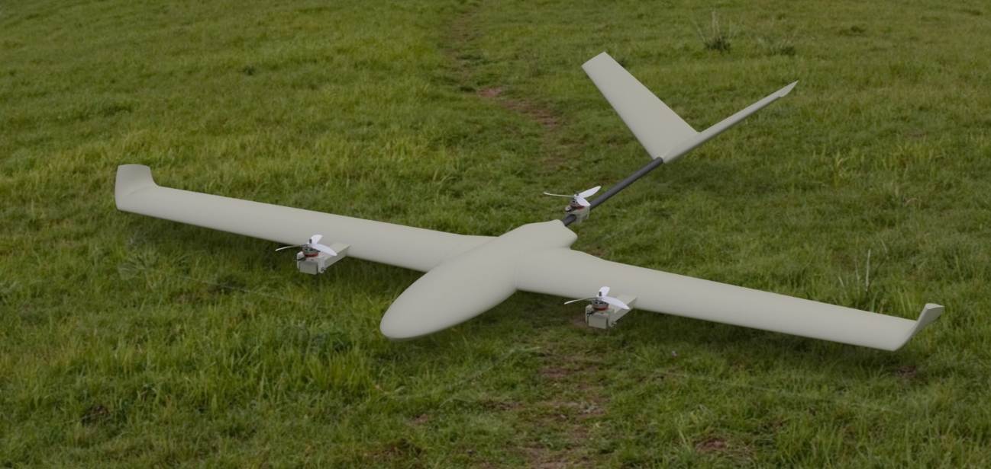
Presentation by
Metin Öz
Harun Üner
Group No:
Vertical Take-off Landing (VTOL) Aircraft
Date 12/01/2025

Slide 2
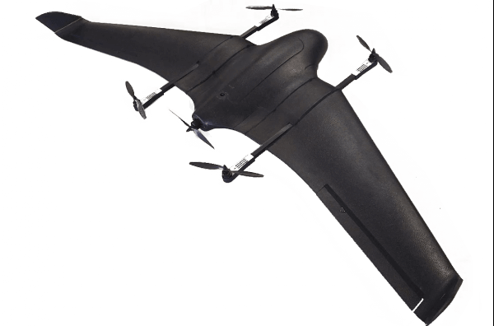
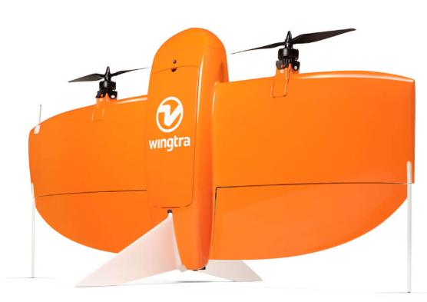
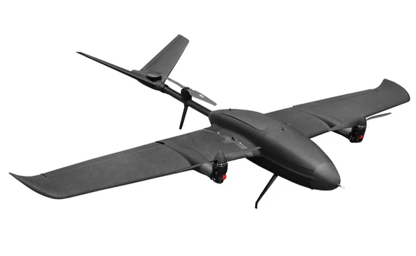
What is VTOL air vehicle?
VTOL is a type of aircraft that can take off and land vertically and also perform forward flight like a fixed winged aircraft.
The Types of fixed wing VTOLs:
Quad-in-Plane VTOLs
Tail-sitter VTOLs
Tiltrotor VTOLs

Slide 3
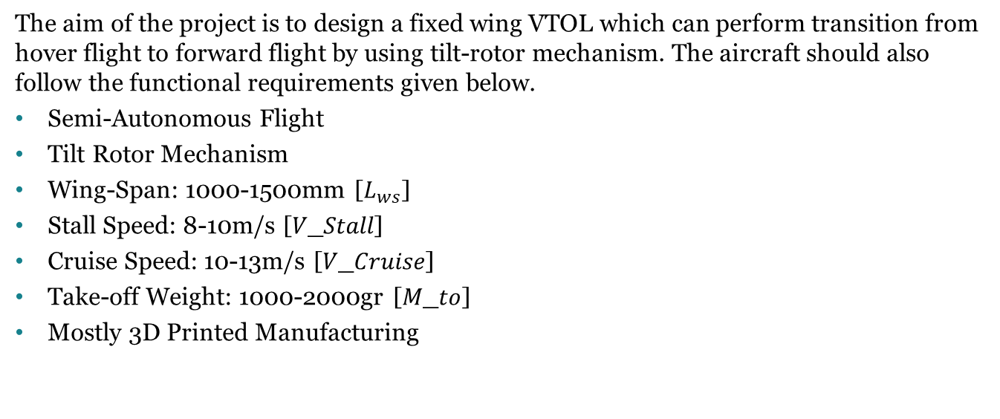
Problem Definition and Functional Requirements:
The aim of the project is to design a fixed wing VTOL which can perform transition from hover flight to forward flight by using tilt-rotor mechanism. The aircraft should also follow the functional requirements given below.
Semi-Autonomous Flight
Tilt Rotor Mechanism
Wing-Span: 1000-1500mm [$L_{ws}$]
Stall Speed: 8-10m/s [𝑉_𝑆𝑡𝑎𝑙𝑙]
Cruise Speed: 10-13m/s [𝑉_𝐶𝑟𝑢𝑖𝑠𝑒]
Take-off Weight: 1000-2000gr [𝑀_𝑡𝑜]
Mostly 3D Printed Manufacturing

Slide 4
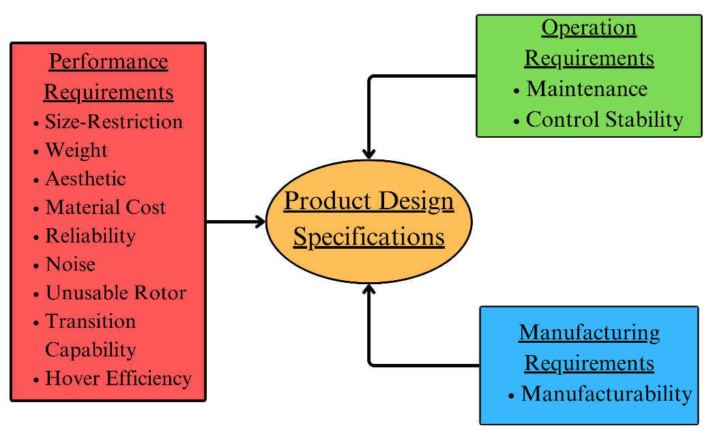
Product Design Specifications
Control Stability
Unusable Rotors
Transition Capabilities
Hover Efficiency

Slide 5
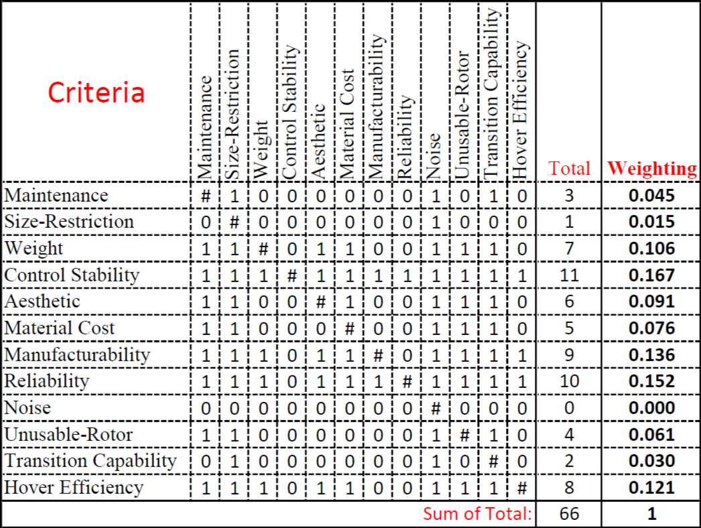
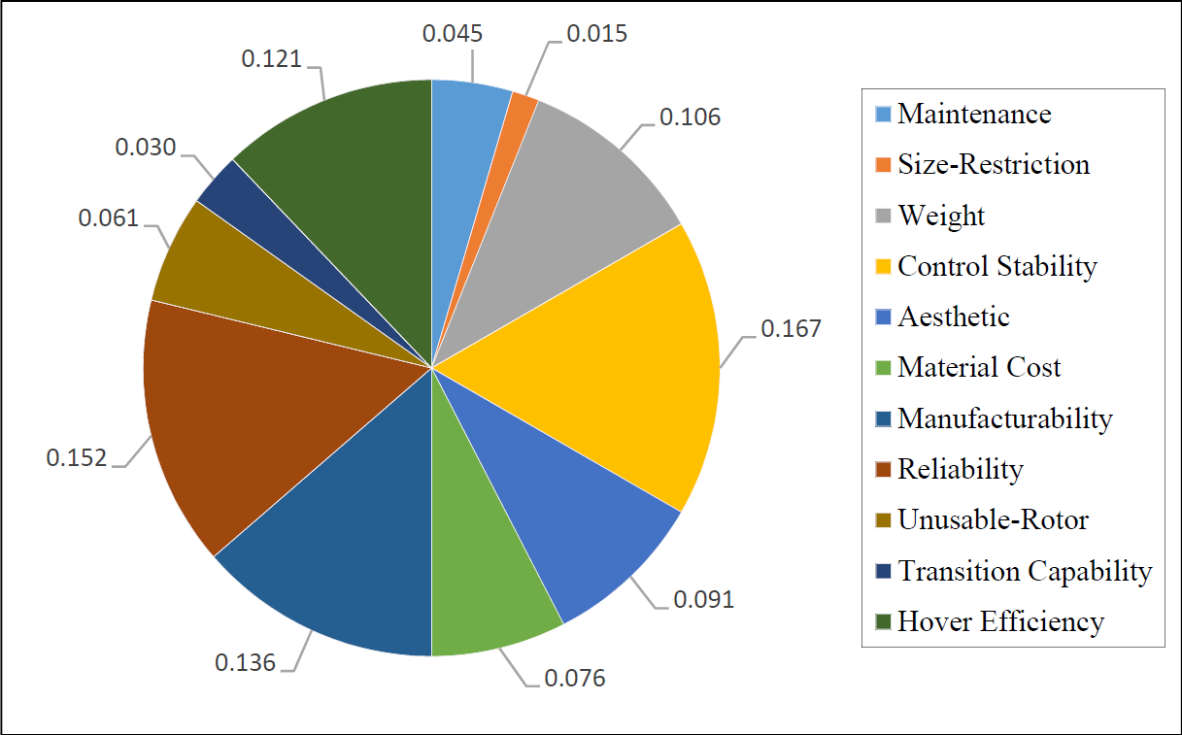
Binary Dominance Matrix

Slide 6
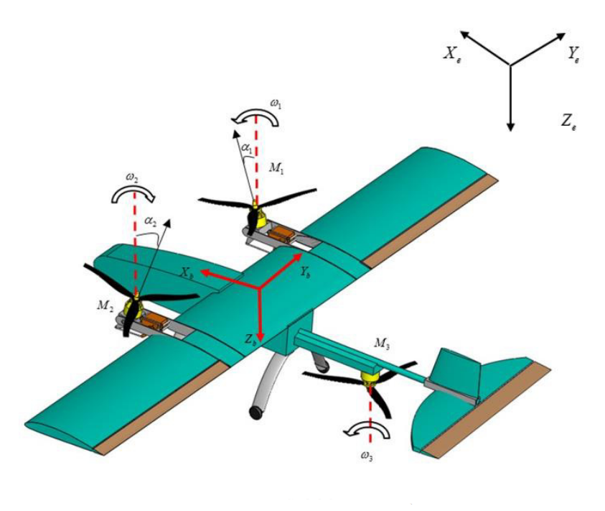
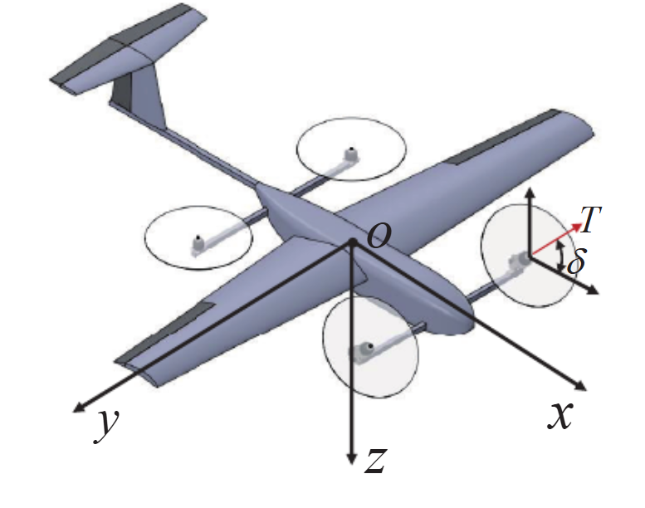
Possible Concepts
Concept-1 Concept-2
Three-Rotor VTOL Four-Rotor VTOL

Slide 7
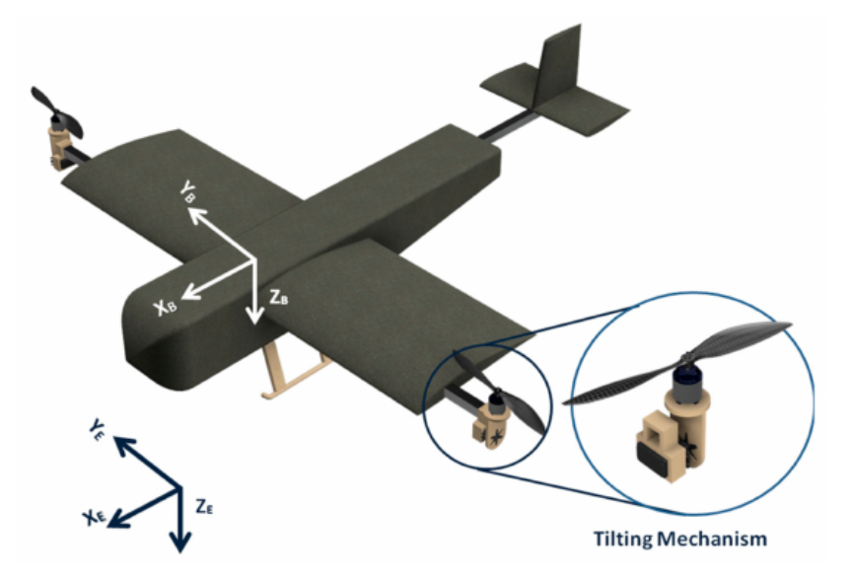
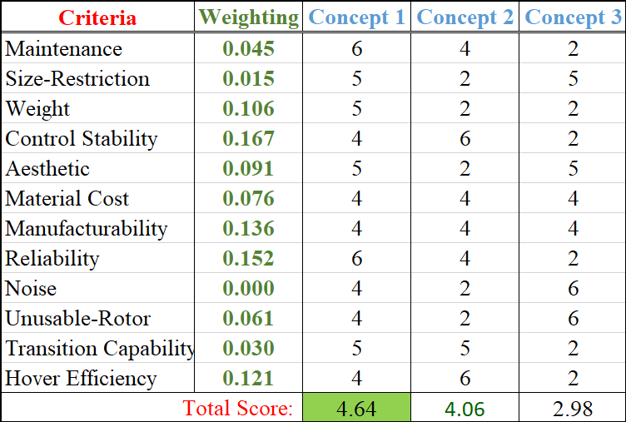
Concept-3 Concept Evaluation
Two-Rotor VTOL

Slide 8
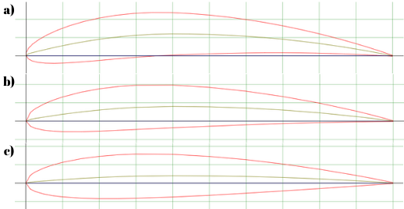
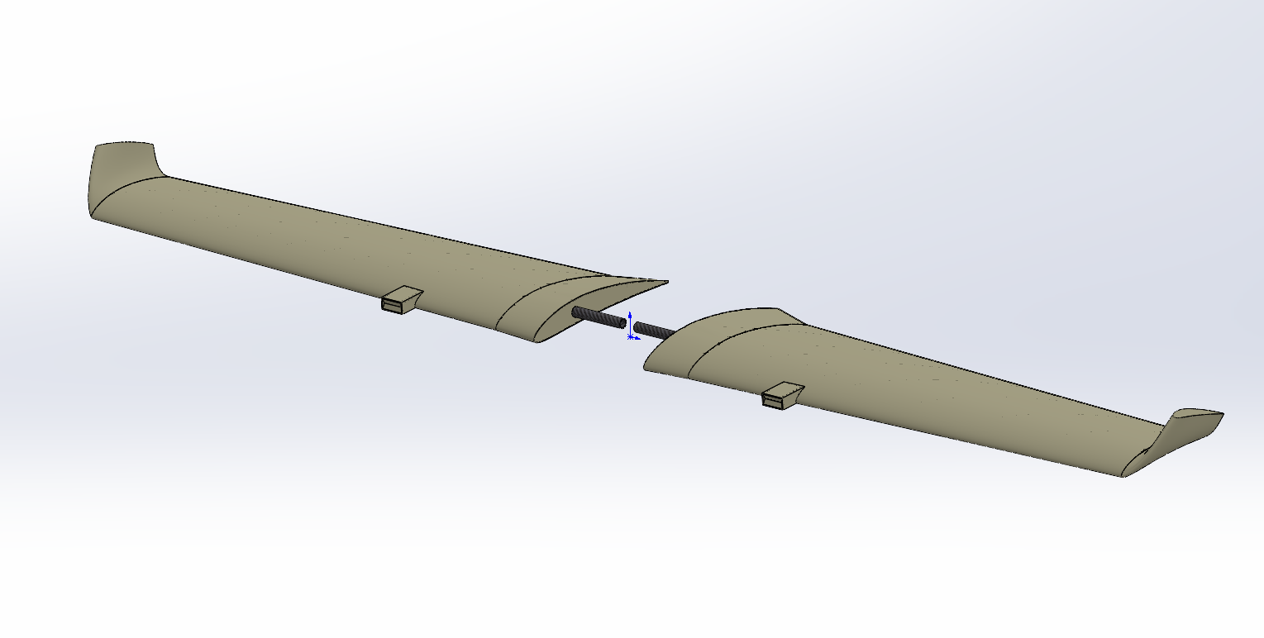
Design Process
Airfoil Selection Wing Design
NACA 6412
NACA 4412
NACA 2412

Slide 9
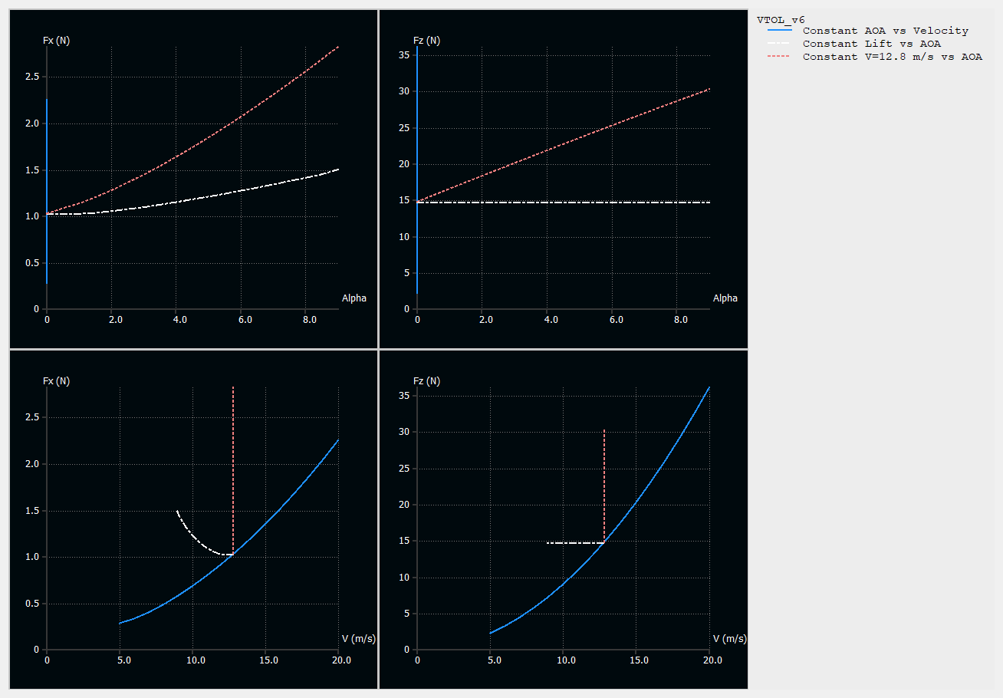
XFLR-5
6 Iteration is performed for
different geometries
Final Iteration:
-Wing Span: 1640mm
-M.A.C: 186mm
-Stall Speed: 8.9m/s @ α=9˚
-Cruse Speed: 13m/s @ α=0˚
(for 1500 g take-off weight)

Slide 10
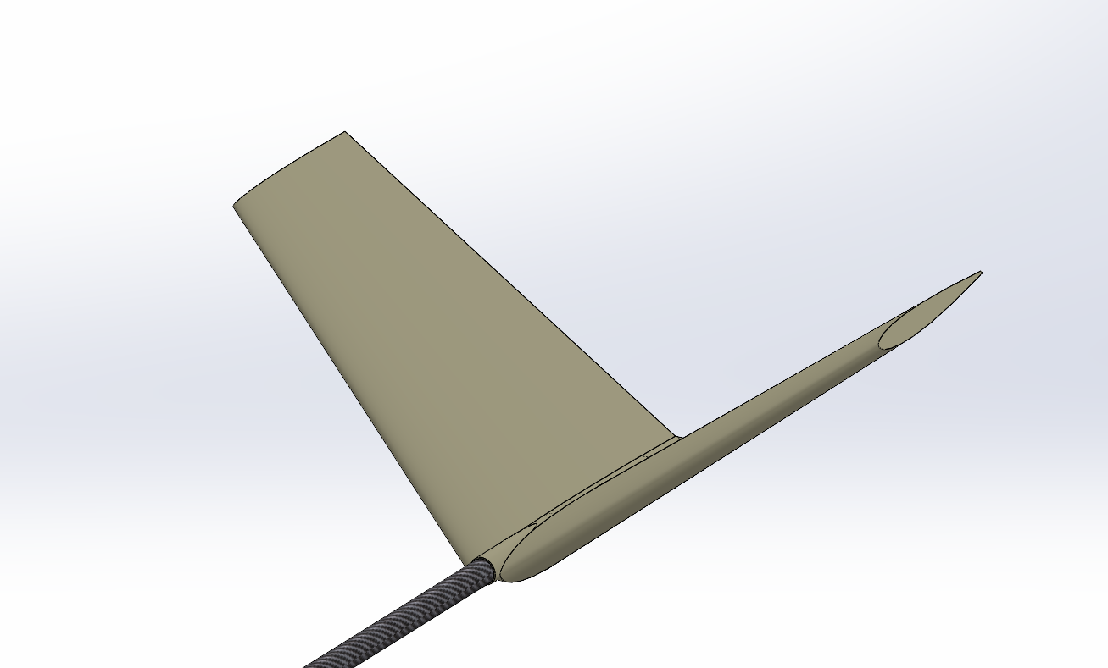
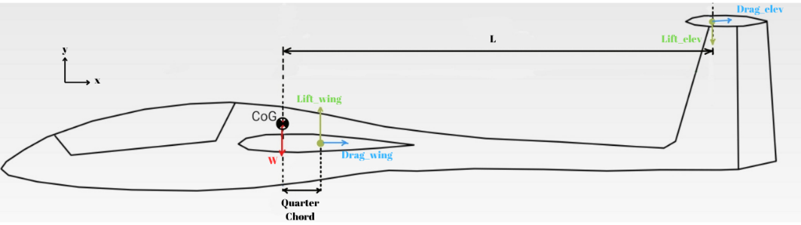
Tail Design
The task of the tail is to balance the pitching moment of the wing.
A tail designed to ensure static stability
NACA-0012 symmetrical airfoil used

Slide 11
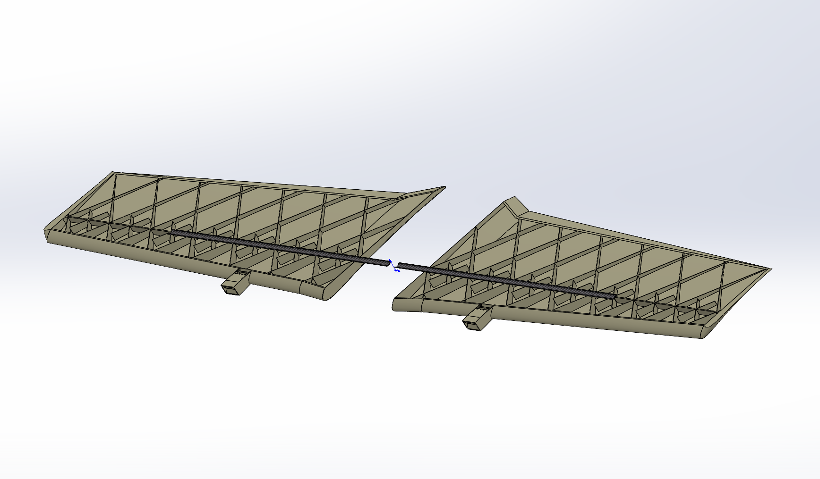
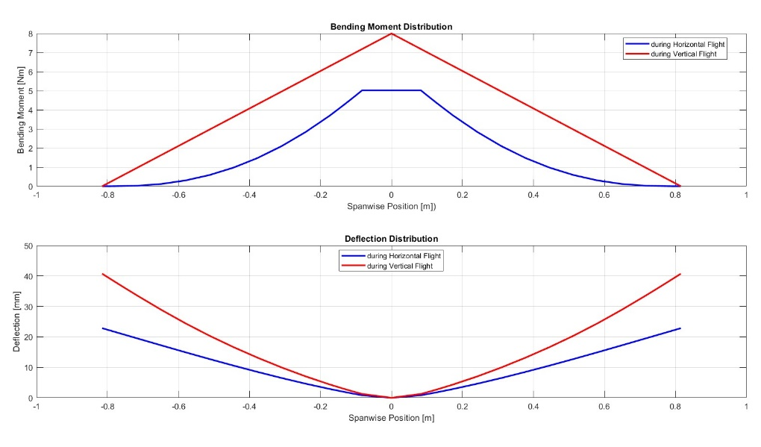
3D design
Internal Structure of The Wing Bending Moment and Deflection
Distribution

Slide 12
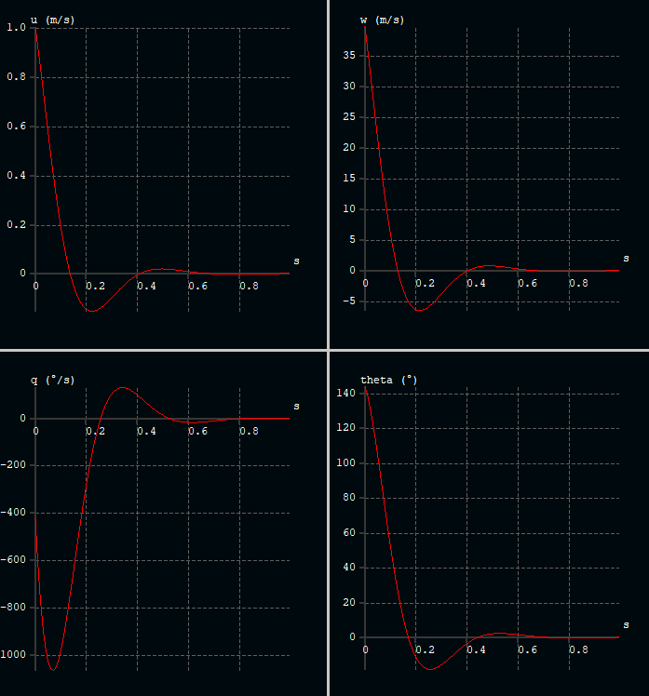
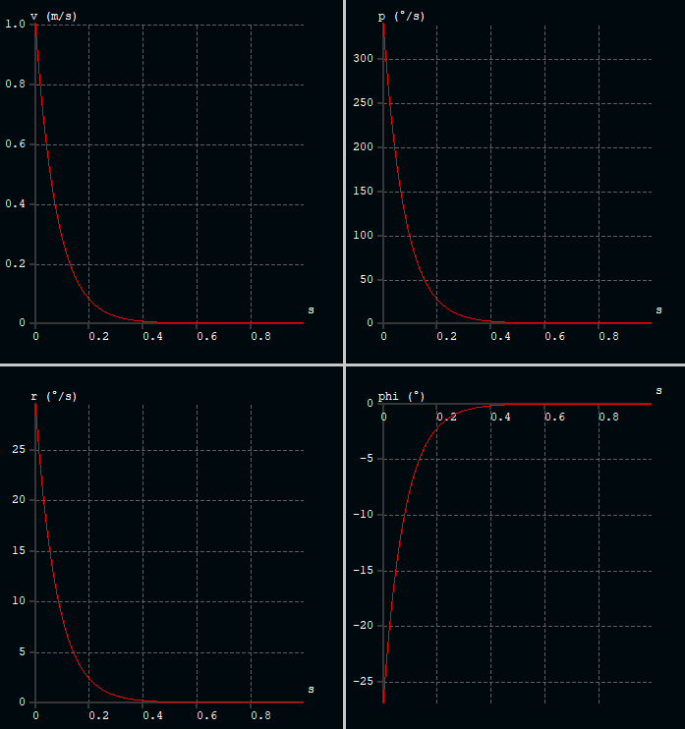
Dynamic Stability
Short-Period Longitudinal Mode
Represent Pitching (Settling 0.6s)
Roll-Damping Lateral Mode
Represent Rolling (Settling 0.5s)

Slide 13
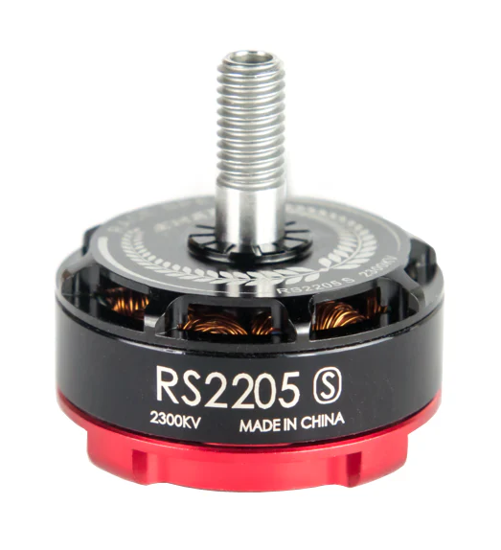
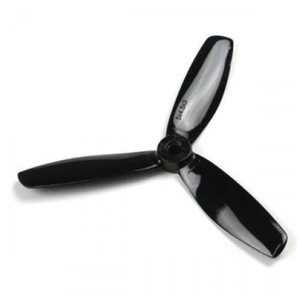
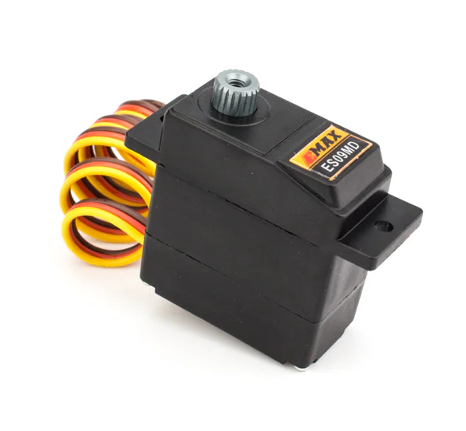
The Selection of Hardware
Emax RS2205S-2300Kv 3 blade 5045 Emax ES09MD
Dual–Bearing servo

Slide 14
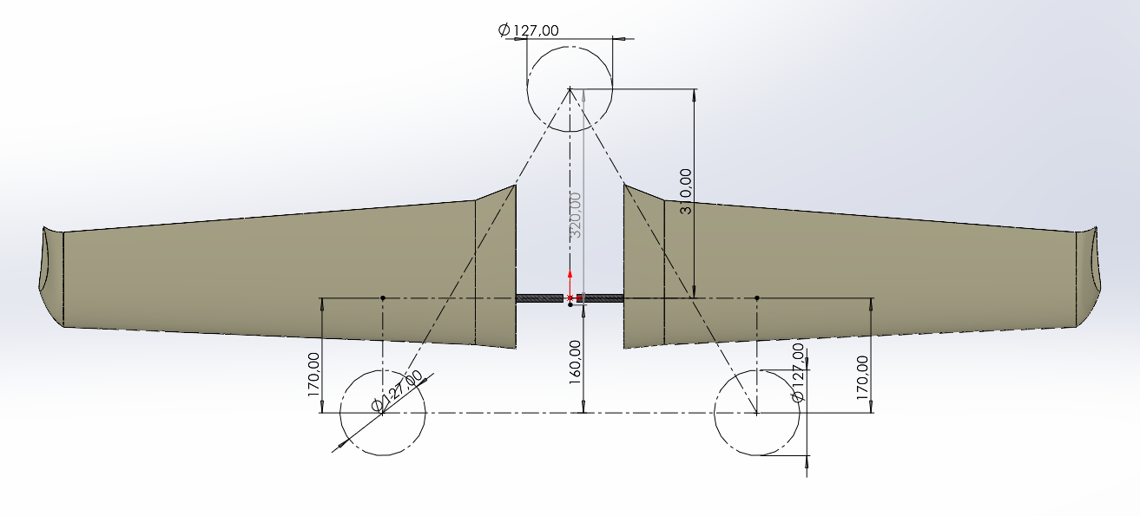
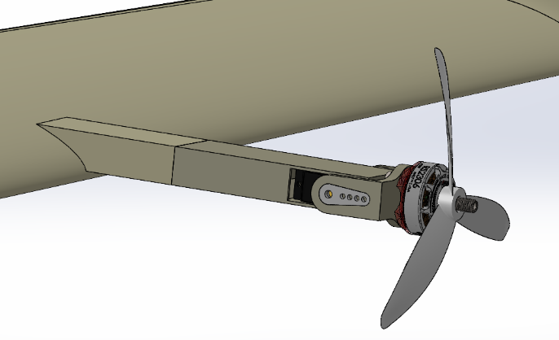
The Designation of Rotors and Tilting Mechanism
The Position of the Rotors Tilting Mechanism

Slide 15
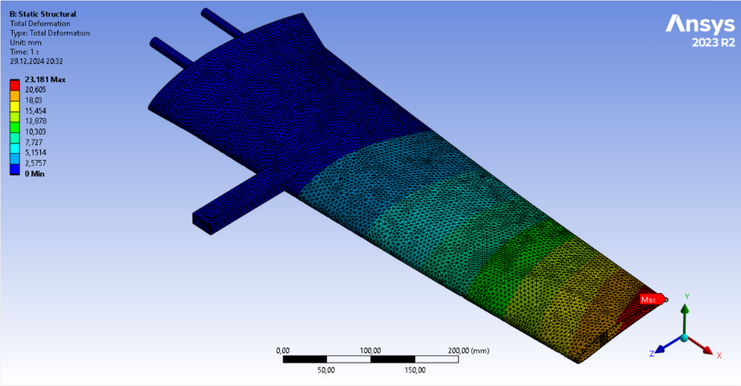
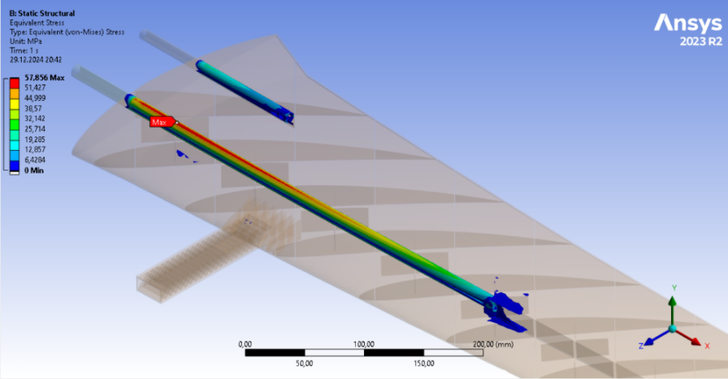
Structural Analysis of the Wing Members

Slide 16
Cost Analysis
Item | Description | Cost (₺)
PLA Filament | Spool of 1 kg PLA filament for application requiring strength | 350
LW-PLA Filament | Spool of 1 kg Light-Weight PLA Filament | 1500
Wing Spar Pipe | 1 meter of CFRP pipe with diameter of 12mm-10mm | 580
Tail Pipe | 1 meter of CFRP pipe with diameter of 14mm-12mm | 700
Adhesives | Adhesives for bonding printed parts | 300
Control Tools | Push-Rods, Horns, Hinges, Canopy-Locks, etc. | 300
Fasteners | Plastic and metal bolts and nuts | 100
Item (pcs) | Description | Cost (₺)
BLDC Motors (3) | Emax RS2205S-2300Kv model BLDC motor | 990
Tilt Servos (2) | Emax ES09MD Dual–Bearing servos used for tilt mechanism | 1300
Control Servos (4) | Emax ES08MA-II Metal Gear servo used for control surfaces | 720
ESC (3) | HSKRC 45A Brushless Electronic Speed Controller | 2100
Flight Controller | Pixhawk 2.4.8 Flight Controller with GPS and Power module | 6800
Airspeed Sensor | Pixhawk Pitot Tube and Airspeed Sensor | 2400
Propeller (4) | OEM 5045 3-Blade Plastic Propellers | 200
Battery | Leopard Power 14.8V 5200mAh Li-Po Battery | 4000
Mechanical Parts: 3.830₺ Electronic Parts: 18.510₺

Slide 17
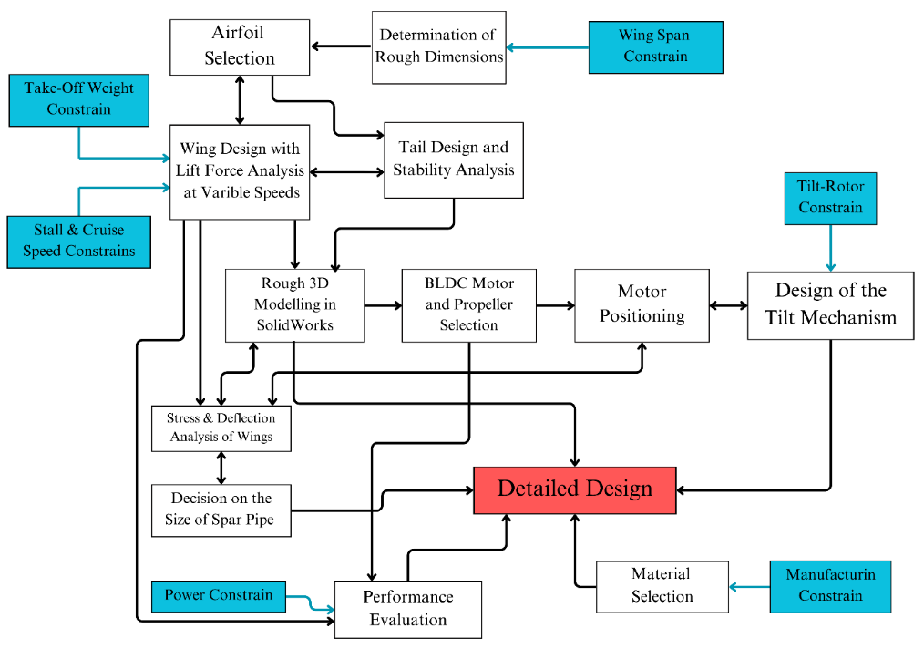
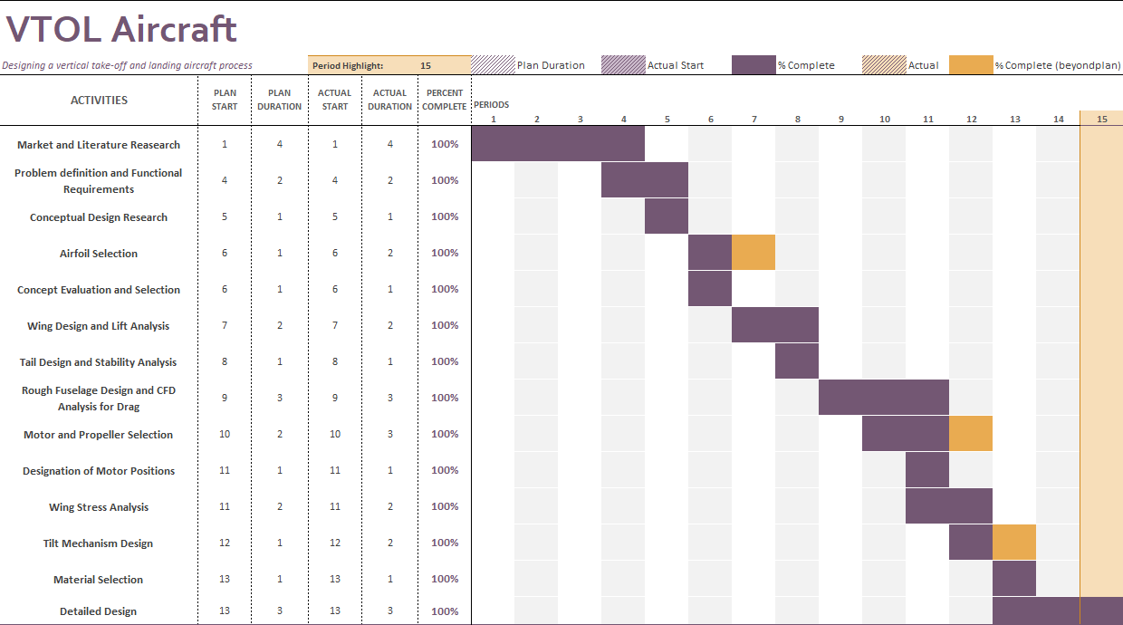
Project Management
Design Tree 1st Semester Gantt Chard

Slide 18
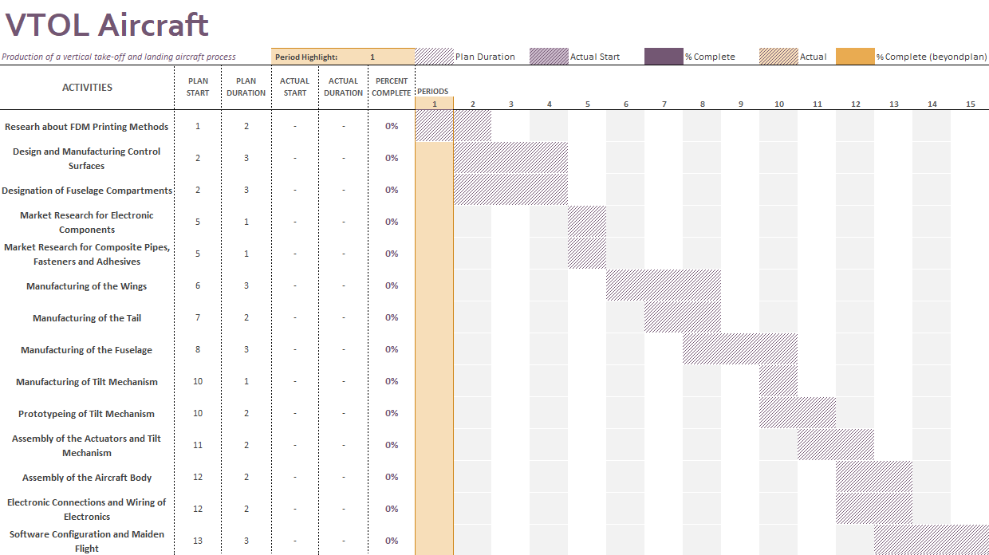
Project Management
2nd Semester Gantt Chard

Slide 19
Thanks for listening ,

